Slide 1
#04 File I/O, Object Streams and Exceptions
Notes:
Give an explanation for file I/O, object streams and exceptions
Relevant theoretical decisions
What is the purpose of data files and how is it used in a C# program?
Name some common file types used for storing data
How can you store and load objects on files?
What is exception handling?
Is it necessary to handle exceptions in a C# program?
What is the difference of caught and uncaught exception?
How can exception in a C# program be handled?

Slide 2
File I/O
Why are files needed?
Usage of files
Common file types
Notes:
Files are a necessity when data needs to be saved, because of either moving of data or storage of data when a program is closed.
A stream is a sequence of bytes that flow from a source to a destination
In a program, we read information from an input stream and write information to an output stream
A program can manage multiple streams simultaneously
Example of a stream are Console.In , Console.Out , Console.Error
Common or known file types/extensions, are i.e. .txt a file that is formatted for viewing in a typical text editor, that it’s using som known encoding formats such as ansi.

Slide 3
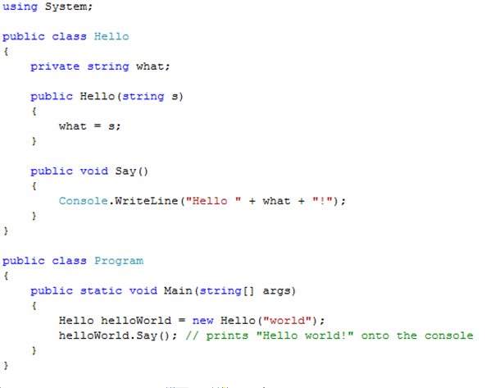
File I/O Example

Slide 4
Object Streams
How to store and load objects on files

Slide 5
Object Streams Example

Slide 6
Exceptions
What is exceptions
Exception handler
Try block
Throw exceptions
Catch exceptions
Notes:
Exceptions handles abnormal conditions. An exception is an object that encapsulates information about an unusual program occurrence.
Exceptions aren’t a protection against user programmed bugs. A bug might cause an exception.
Errors are caused by user action. i.e. a user types in a number where a letter is expected. An error might cause an exception.
Some things causes an exception that is not a bug nor an error, such as running out of memory.
The exception handler is a block of code designed to handle the exception.
try block is a block where you throw exceptions in.
throw keyword are used when you need to throw an exception, i.e. if you think your application has done something abnormal. It can be used when you’re debbugging. Example: throw new System.IO.IOException()
catch is used to handle the thrown exception is also used together with the try. Best practice is to specify which exception the catch should take care of!!!

Slide 7
File I/O and Exceptions Example
using System;
using System.IO;
class Test
{
public static void Main()
{
try
{ // Create an instance of StreamReader to read from a file.
// The using statement also closes the StreamReader.
using(StreamReader sr = new StreamReader("TestFile.txt"))
{
String line; // Read and display lines from the file until the end of the file is reached.
while ((line = sr.ReadLine()) != null)
{
Console.WriteLine(line);
}
}
}
catch (Exception e)
{ // Let the user know what went wrong.
Console.WriteLine("The file could not be read:"); Console.WriteLine(e.Message);
}
}
}

Slide 8
Use in our program

Slide 9
Use in our program

